Slide 1
Mason Prather
Project Demo Reel

Slide 2
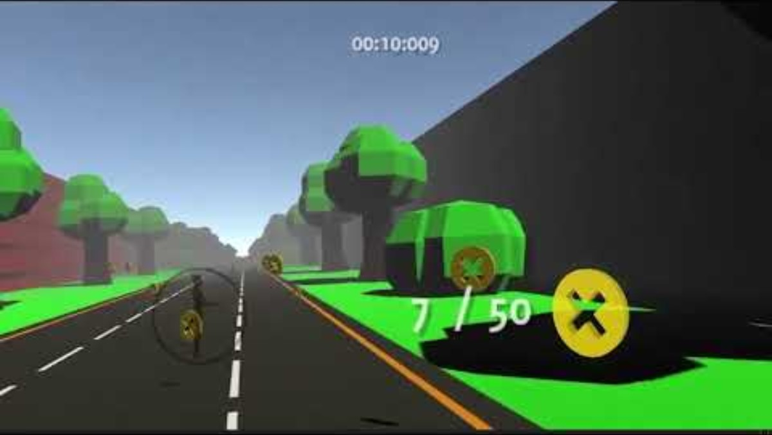
Scooter Coin CGDD 4490 - Spring 2022 - C-Day 1st Place in Undergraduate Capstone

Slide 3
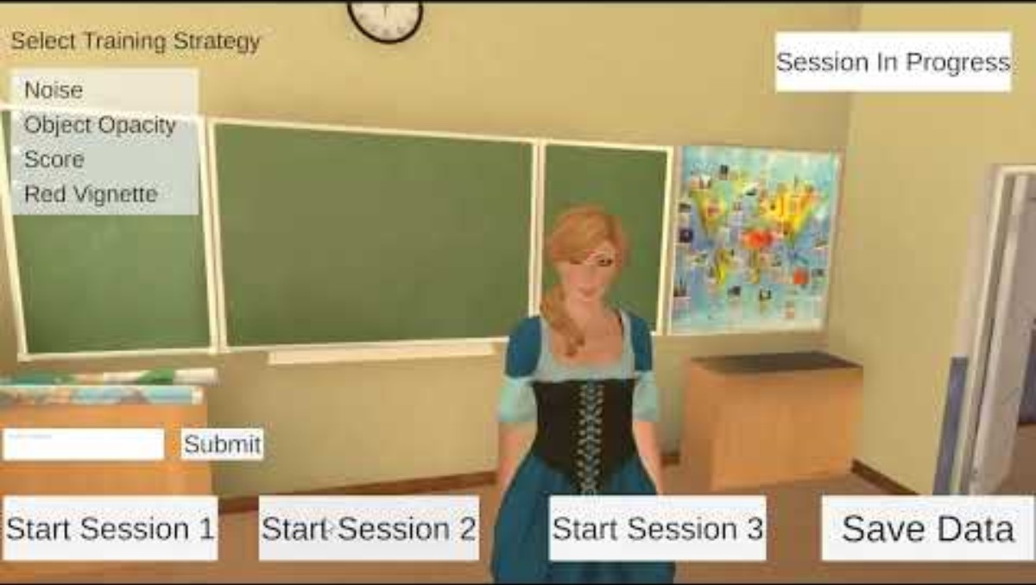
Eye Tracking Attention Training Research Project - KSU Realities Lab - Fall 2022

Slide 4
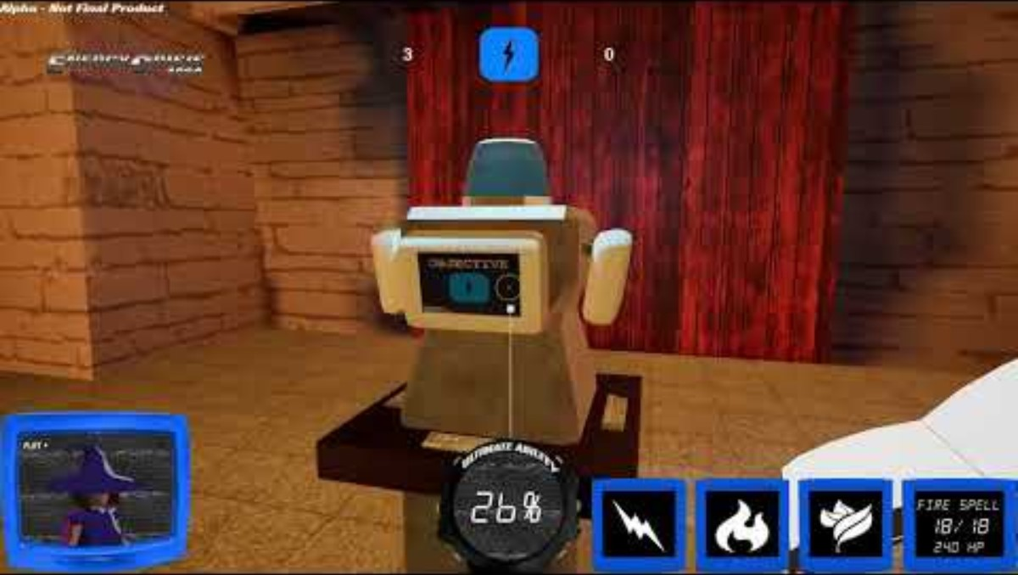
Energy Crisis 1994 CGDD 4814 – Senior Project Spring 2022 – Solo Development
Notes:
All assets were developed during Fall 2021 and Spring 2022 semesters
The only outsourced assets were textures and fonts
The game fully functions as an online multiplayer game with a client and host build of the game
Tested on LAN

Slide 5
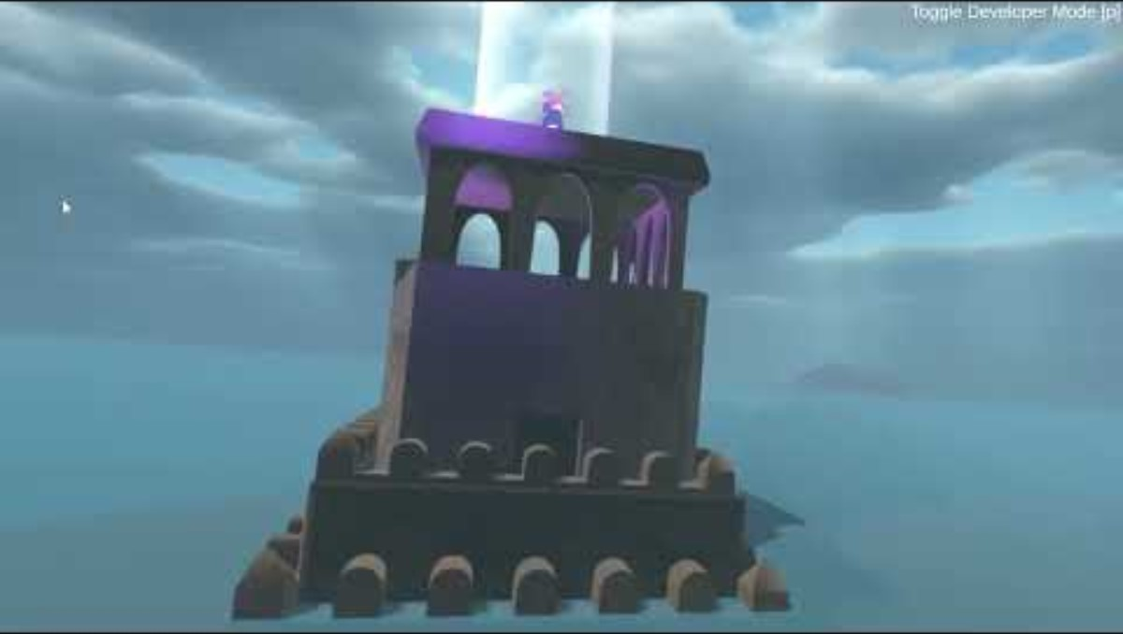
Schwer VR Research Project - KSU Realities Lab - Fall 2023

Slide 6
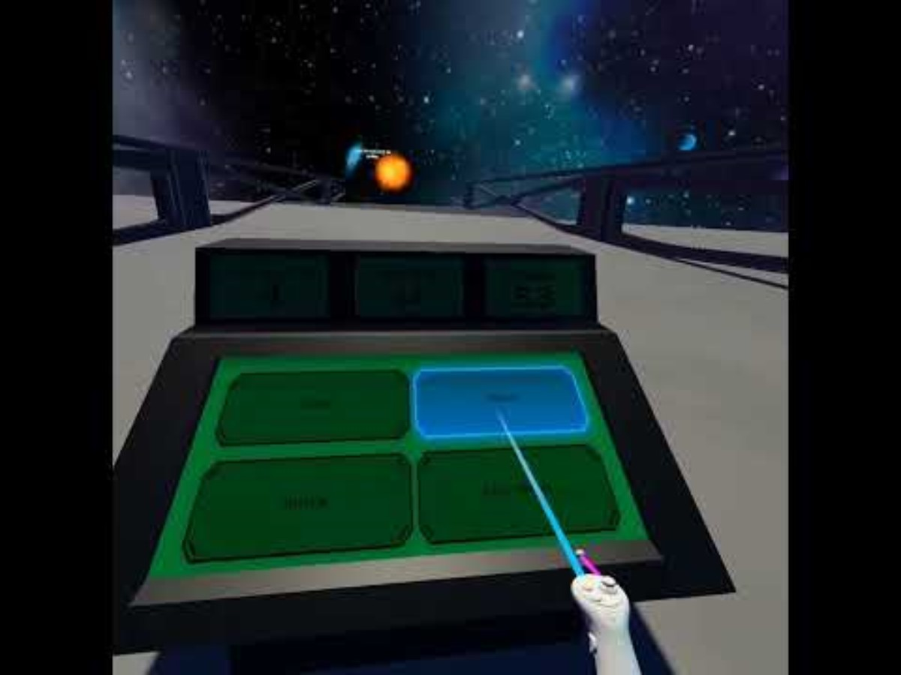
Cyber Attack Escape Research Project - KSU Realities Lab - Fall 2023 & Spring 2024

